Slide 1
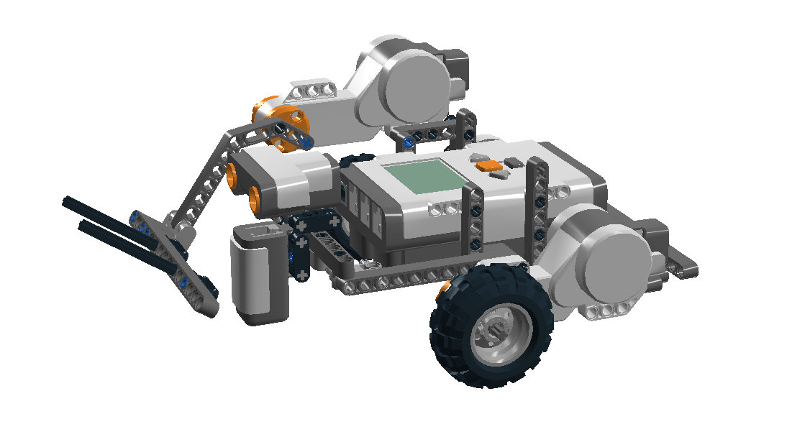
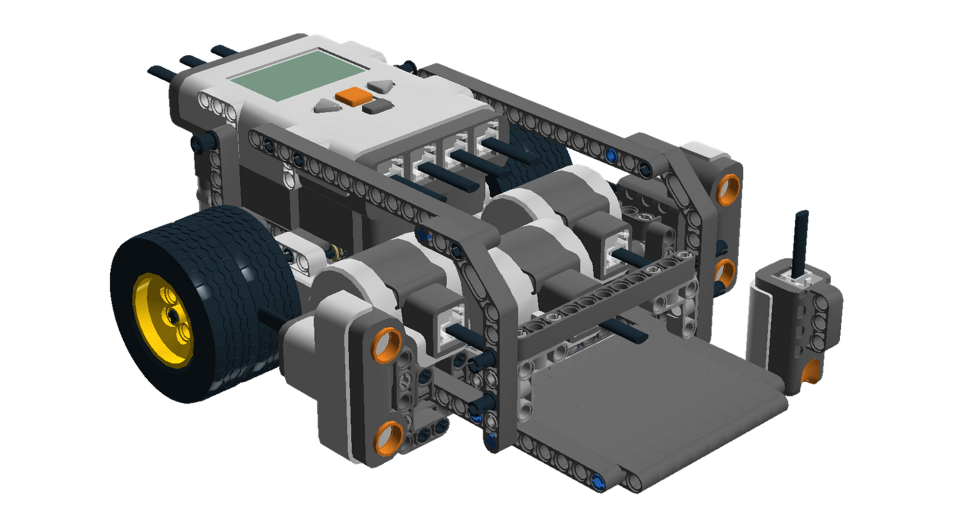
SUMO BOTS
THREE MOTORS
TWO WHEELS
A LIGHT SENSOR FACING THE GROUND

Slide 2
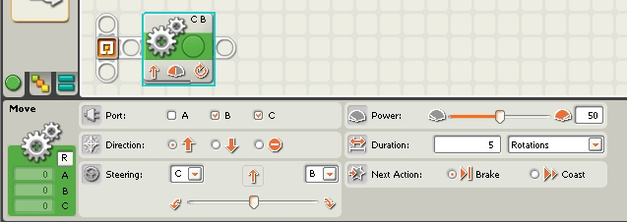
Move Block
Moves two motors simultaneously
*Degrees recommended movement duration
↑Power ↓Precision

Slide 3
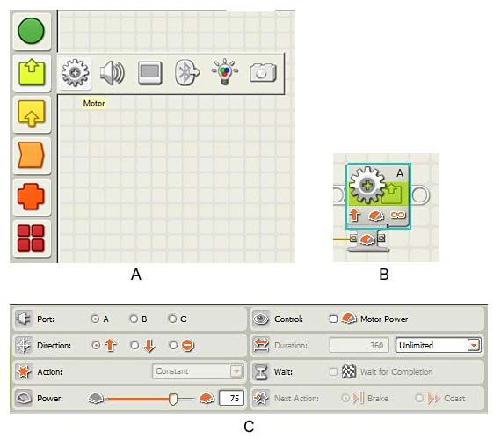
Motor Block
Moves an individual motor
Wait for Completion: Waits until movement is finished before running next block

Slide 4
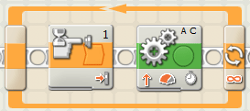
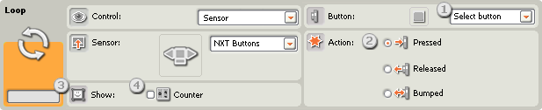
Loop Block
Repetitively runs the blocks inside if a condition is met(forever, button push, etc)

Slide 5
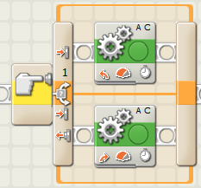
Switch
This is where you use the sensor
Runs one chunk of blocks if a condition is met, otherwise it will run the other

Slide 6
Rules
Two robots compete in a head-to-head match following the basic system of traditional human sumo matches. Robots are allowed no weapons, and are not allowed to flip each other. The sole purpose is a pushing match between the two robots to force the other from the arena.

Slide 7
